Slide 1
THE Tableau HR Scorecard : Measuring Success in Talent Management
A. KARTHI | [C21UG155MAT001]
N. POOVARASAN | [C21UG155MAT002]
S. SANTHOSH | [C21UG155MAT003]
S. SRIRAM | [C21UG155MAT005]
Department of Mathematics, Don Bosco College -636 809
Mentor name: k.JAI SHANKAR
1.0: INTRODUCTION
Data visualization is a powerful and essential tool in the field of data analysis and Communication. It involves representing data in a graphical or visual format, making complex information more accessible, understandable, and actionable. Through various charts, graphs, maps, and other visual elements, data visualization transforms raw data into meaningful insights, patterns, and trends.
The primary goal of data visualization is to simplify the interpretation of data, enabling both experts and non-experts to grasp the information quickly. It allows individuals to see
connections and correlations, identify outliers, and draw informed conclusions from the data presented. Data visualization is widely used across various fields, including business, science, healthcare, journalism, and many others, as it aids decision-making, storytelling, and effective communication.

Slide 2
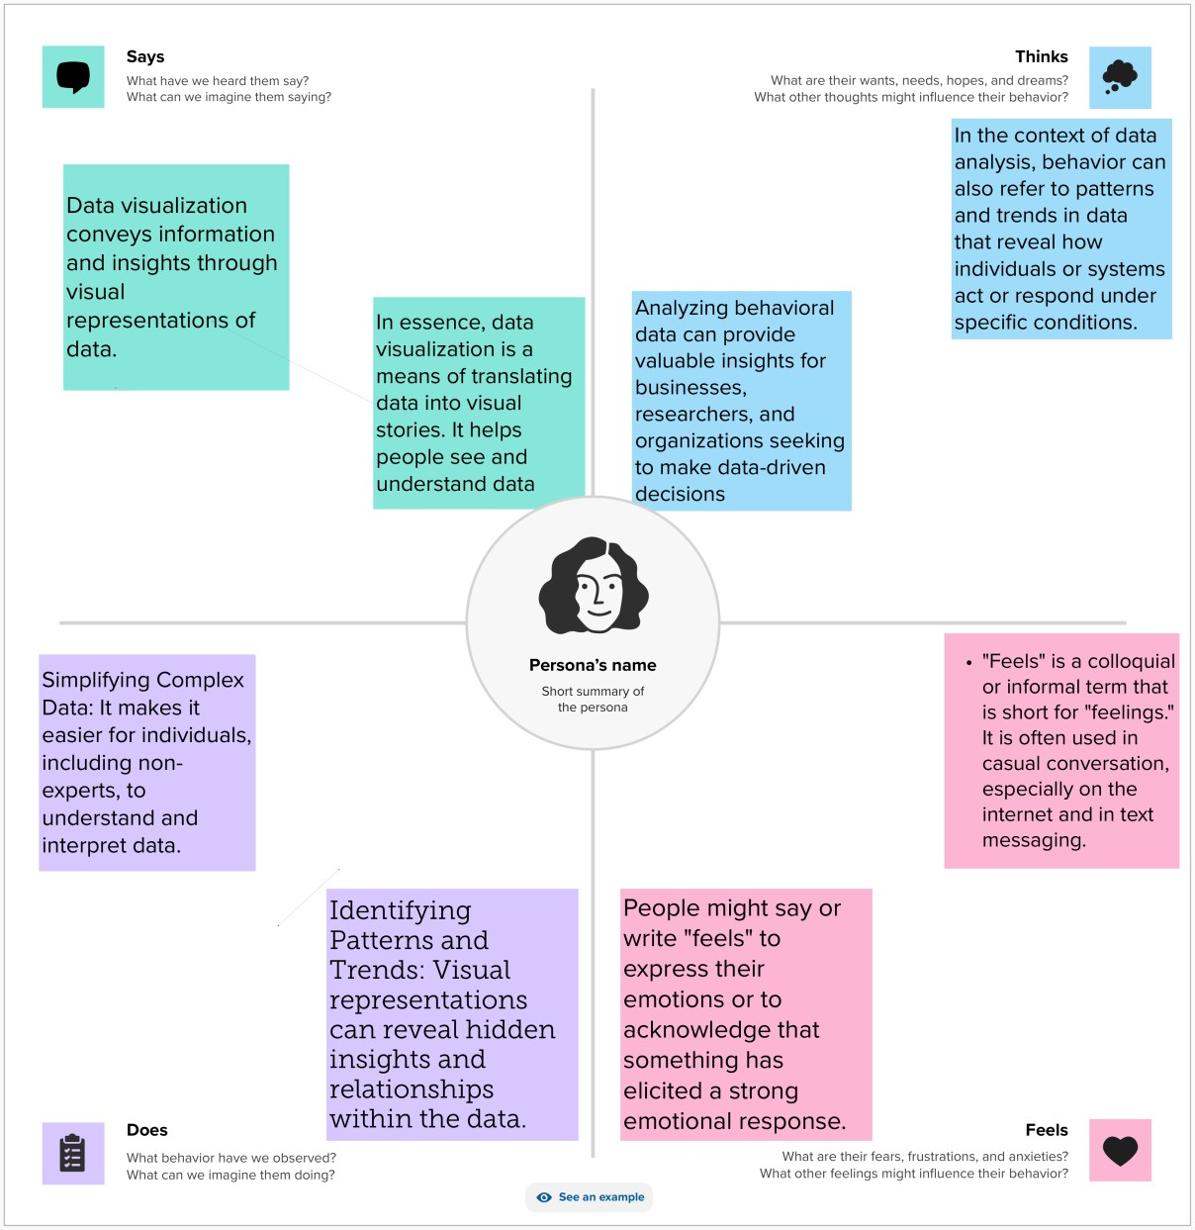
2.0 Empathy MAP
2.0.1: Details:
An Empathy Map consists of four quadrants. The four quadrants reflect four key
traits, which the user demonstrated/possessed during the observation/research stage. The four quadrants refer to what the user: Said, Did, Thought, and Felt.

Slide 3
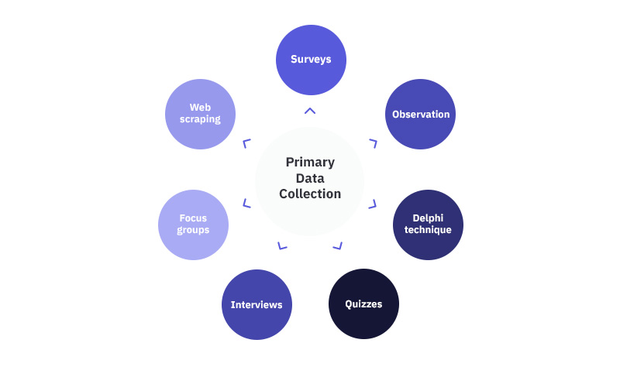
2.1: Brain storme:
Prioritize : Your team should all be on the same page about what's important moving forward. Place your ideas on this grid to determine which ideas are important and which are feasible.

Slide 4
KPI
Active employees |  |  |  |  |  |  |  |  |  |  |  |  |  |  |  |  |  |  |  |  |  |  |  | Avg. Age 36.92
Age
Attrition count
Daily Rate
Employee Count
Hourly Rate
Job Involvement
Monthly Income
Monthly Rate
Standard Hours
attrition count
 | 0M | 2M |  | 4M |  | 6M |  | 8M |  | 10M |  | Value | 12M |  | 14M |  | 16M |  | 18M |  | 20M |  | 22M
Active employees, Age, Attrition count , Daily Rate, Employee Count, Hourly Rate, Job Involvement, Monthly Income, Monthly Rate, Standard Hours and attrition count . Color shows average of Age. The data is ﬁltered on sum of Job Satisfaction1 and sum of Years In Current Role. The sum of Job Satisfaction1 ﬁlter includes everything. The sum of Years In Current Role ﬁlter includes everything. The view is ﬁltered on Active employees, average of Age, sum of Monthly Rate, sum of Employee Count and sum of Age. The Active employees ﬁlter keeps all values. The average of Age ﬁlter includes everything. The sum of Monthly Rate ﬁlter ranges from 21,040,262 to 21,040,262. The sum of Employee Count ﬁlter includes everything. The sum of Age ﬁlter includes everything.

Slide 5
Attrition by Gender
Attrition count
Gender1
Female
Male
Gen.. ⁰
1
Fem..
87
Male
150
0
1
Attrition count
Sum of Attrition count and sum of Attrition count for each Gender1. Color shows details about Gender1. The marks are labeled by sum of Attrition count .

Slide 6
department wise attrition
Department1
HR
R&D Sales
5.06%
38.82%
56.12%
% of Total Attrition count . Color shows details about Department1. The marks are labeled by % of Total Attrition count .

Slide 7
No of employee by age group
Age (bin)
Employee Count
5
274
250
200
Employee Count
150
100
50
0
16 20 24 28 32 36 40
Sum of Employee Count for each Age (bin). Color shows sum of Employee Count.
44
48
52
56
60

Slide 8
Job satisfaction Rating
Job Role1 | Job Satisfaction1
 | 1 | 2 | 3 | 4 | Grand Total
Healthcare Representative | 26 | 19 | 43 | 43 | 131
Human Resources | 10 | 16 | 13 | 13 | 52
Laboratory Technician | 56 | 48 | 75 | 80 | 259
Manager | 21 | 21 | 27 | 33 | 102
Manufacturing Director | 26 | 32 | 49 | 38 | 145
Research Director | 15 | 16 | 27 | 22 | 80
Research Scientist | 54 | 53 | 90 | 95 | 292
Sales Executive | 69 | 54 | 91 | 112 | 326
Sales Representative | 12 | 21 | 27 | 23 | 83
Grand Total | 289 | 280 | 442 | 459 | 1,470
Sum of Employee Count broken down by Job Satisfaction1 vs. Job Role1.

Slide 9
Education ﬁeld wise attrition
Education Field1
Human Resources
7
Life Sciences
89
Marketing
35
Medical
63
Other
11
Technical Degree
32
0
5
10
15
20
25
30
35
40 45 50 55
Attrition count
60
65
70
75
80
85
90
95
Sum of Attrition count for each Education Field1. The marks are labeled by sum of Attrition count .

Slide 10
Attrition rate by gender for diﬀerent age group
CF age band
Gender1
Female
Male
2
2
43
14
9
3
MIN(1)
1
1
1
1
1
1
18
1
MIN(1)
69
16
20
37
8
0
Under 25
0
25 - 34
35 - 44
45 - 54
Over 55
MIN(1) and MIN(1) for each CF age band. For pane MIN(1): Color shows details about Gender1.

Slide 11
HR ANALYTICS DASHBOARD
Attrition by Gender
KPI
department wise attrition
Active empl..
Gen.. | Attrition count 0 1
Fem..
 | 87
Male
 | 150
 | 0 1 Attrition count
5.06%
38.82%
56.12%
Age
Attrition co..
Daily Rate
Employee C..
Hourly Rate
Job Involve.. Monthly Inc..
Monthly Ra..
0M 2M 4M 6M 8M
Value
No of employee by age group
Attrition rate by gender for diﬀerent age group
Job satisfaction Rating
Age (bin)
Job Role1 | Job Satisfaction1
 | 1 |  | 2 | 3 | 4 | Gran..
Healthcare .. |  | 26 | 19 | 43 | 43 | 131
Human Res.. |  | 10 | 16 | 13 | 13 | 52
Laboratory .. |  | 56 | 48 | 75 | 80 | 259
Manager |  | 21 | 21 | 27 | 33 | 102
Manufactur.. |  | 26 | 32 | 49 | 38 | 145
Research Di.. |  | 15 | 16 | 27 | 22 | 80
Research Sc.. |  | 54 | 53 | 90 | 95 | 292
Sales Execu.. |  | 69 | 54 | 91 | 112 | 326
Sales Repre.. |  | 12 | 21 | 27 | 23 | 83
Grand Total |  | 289 | 280 | 442 | 459 | 1,470
250
200
150
100
50
0
2
CF age band
2
Employee Count
14
9
1 1
3
MIN(1)
1
69
43
1 1
16
20
1
18
1
MIN(1)
37
8
0
25 - 34
35 - 44
45 - 54
Over 55
Under 25
0
20 28 36 44 52 60
Education ﬁeld wise attrition
Education Field1
Human Resources Life Sciences |  |  |  |  |  |  |  |  |  |  |  |  |  |  |  |  |  |  | 89
Marketing Medical |  |  |  |  |  |  |  |  |  |  |  |  |  | 63
Other Technical Degree |  |  |  |  |  |  | 32
 | 0 | 10 |  | 20 |  | 30 |  | 40 |  | 50 Attrition count |  | 60 |  | 70 |  | 80 |  | 90

Slide 12
HR Analytics
Active employees, Age, Attrition count , Daily Rate, Employee Coun.. | Sum of Attrition count and sum of Attrition count for each Gende.. | % of Total Attrition count . Color shows details about Depart.. | Sum of Employee Count for each Age (bin). Color shows su..
Active empl..
Age
Attrition co..
Daily Rate
Employee C..
Hourly Rate
Job Involve..
Monthly Inc..
Monthly Ra..
Standard H..
attrition co..
 | 0M | 5M |  | 10M Value |  | 15M |  | 20M
Avg. Age
36.92

Slide 13
HR Analytics
Active employees, Age, Attrition count , Daily Rate, Employee Coun.. | Sum of Attrition count and sum of Attrition count for each Gende.. | % of Total Attrition count . Color shows details about Depart.. | Sum of Employee Count for each Age (bin). Color shows su..
Gen.. | Attrition count 0 1
Fem..
 | 87
Male
 | 150
 | 0 1 Attrition count
Gender1
Female
Male

Slide 14
DEPARTMENT WISE ATTRITION
Department
HR
R&D Sales
Sales 30.34%
HR 4.29%
R&D 65.37%
Department and % of Total Count of HR Data.xlsx - HR data.csv. Color shows details about Department. The marks are labeled by Department and % of Total Count of HR Data.xlsx - HR data.csv. The data is ﬁltered on Education, which keeps Associates Degree, Bachelor's Degree, Doctoral Degree, High School and Master's Degree.

Slide 15
No.of emplotees by age group
274
Employee Count
219
5
274
245
175
139
131
92 ₇₇
54
42
17
5
16 20 24 28 32 36 40 44 48 52 56
Sum of Employee Count for each Age (bin). Color shows sum of Employee Count. The marks are labeled by sum of Employee Count.
6

Slide 16
Job Satisfaction and rating
Job Role
131
Employee Count
Healthcare Representative
Human Resources Laboratory Technician
Manager Manufacturing Director Research Director Research Scientist Sales Executive
Sales Representative
52
326
52
259
102
145
80
292
326
83
Grand Total
1,470
0
500
1000
1500
2000 2500
Job Satisfaction
3000
3500
4000
4500
Sum of Job Satisfaction for each Job Role. Color shows sum of Employee Count. The marks are labeled by sum of Employee Count.

Slide 17
Education ﬁeld wise attrition
Human Resources
Life Sciences
Current Employees
Marketing
Medical
Current Employees
Other
Technical Degree
Count of HR Data.xlsx - HR data.csv for each Education Field. The marks are labeled by CF attrition label.

Slide 18
Data Visualization
DEPARTMENT WISE ATTRITION
Department
HR
R&D Sales
No.of emplotees by age group
Employee Count
Sales 30.34%
HR 4.29%
5
274
139
245
274
219
175
131
92
77
42
5
R&D 65.37%
17
54
20
28
36
44
52
60
Job Satisfaction and rating
Education ﬁeld wise attrition
Job Role
Healthcare Representative
Human Resources Laboratory Technician
Manager
Manufacturing Director Research Director Research Scientist Sales Executive Sales Representative
Human Resources
259
Life Sciences
Marketing Medical Other
Technical Degree
Current Employees
145
326
1,470
Grand Total
0K 1K
2K 3K 4K
Job Satisfaction
5K

Slide 19
Story 2
Department and % of Total Count of HR Data.xlsx - HR data.cs.. | Sum of Job Satisfaction for each Job Role. Color show.. | Sum of Job Satisfaction for each Job Role. Color show.. | Count of HR Data.xlsx - HR data.csv for each Education Field. The ..
Department
HR
R&D Sales
Sales 30.34%
HR 4.29%
R&D 65.37%

Slide 20
ADVANTAGES:
Identifying Geographic Trends: Maps and geospatial visualizations can reveal geographic trends and patterns, making them valuable for location-based data analysis.
Storytelling: Visualizations can be used to tell compelling data stories, making it easier to convey the narrative behind the data and engage the audience.
Comparative Analysis: Visualizations facilitate easy comparison of different data sets, enabling analysts to draw meaningful conclusions from the data.
Time Series Analysis: Time-series visualizations help in tracking and analyzing trends over time, which is critical in fields like finance, economics, and climate science.
DISADVANTGE:
Interactivity Challenges: While interactivity can be an advantage, it can also make visualizations more complex and harder to share, especially when dealing with printed or static formats.
Limited for Qualitative Data: Data visualization is more suited to quantitative data. It can be challenging to represent purely qualitative or textual information effectively.
Sensitivity to Scale: Some visualizations may appear differently when data scales change. This can affect the perception of trends and patterns.

Slide 21
Conclusion:
In conclusion, data visualization is a powerful and versatile tool with numerous
advantages, but it also has its share of limitations and potential pitfalls. When used effectively, data visualization can improve data comprehension, support informed decision-making, and facilitate effective communication of insights. It allows for
the exploration of data, pattern recognition, and real-time monitoring, making it invaluable in various fields and applications.

